Slide 1


Supply Chain For Biofuel
Presented By:
Vaibav Chopade
Rohit Wakde
Ganesh Ghuge
Arti Kabade

Slide 2
Overview
Introduction
Objectives
Problem Statement
Solution
ER- diagram
Technology
Implementation
Future Upgradation
Conclusion

Slide 3
Introduction
what is Biofuel?
Biofuel is the fuel which is produced from organic products and wastes.
The common commercially used biofuels are bioethanol, biodiesel and biomethane.
Bioethanol is made from sugar, algae, wheat and sugar beat.
Biodiesel is made from vegetable oil, algal lipids and animal fats.
Biomethane can be produced from waste organic material ,sewage and domestic wastes.

Slide 4
Objectives
Efficient Supply Chain Operation.
Cost Reduction.
Supplier Relationship Management.
Environmental Sustanability.

Slide 5
Problem Statement
Suggest an improvised way of tackling the issue of creating a consistent supply chain to augment the use of Biofuels.

Slide 6
Solution
A user friendly web application to build Biofuel supply chain management.

Slide 7

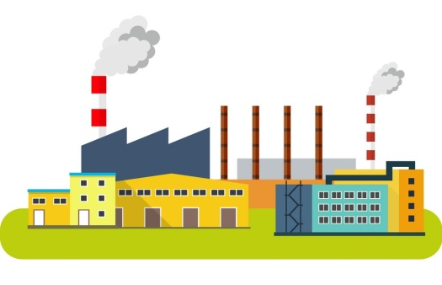


Raw/Bio Waste Supplier will post the waste availability
Picks up the raw material from the supplier
Company portal
Books Raw Materials
Processes and stores in warehouse
Send products to Distributor
Manufacturer
Warehouse
Distributor

Slide 8
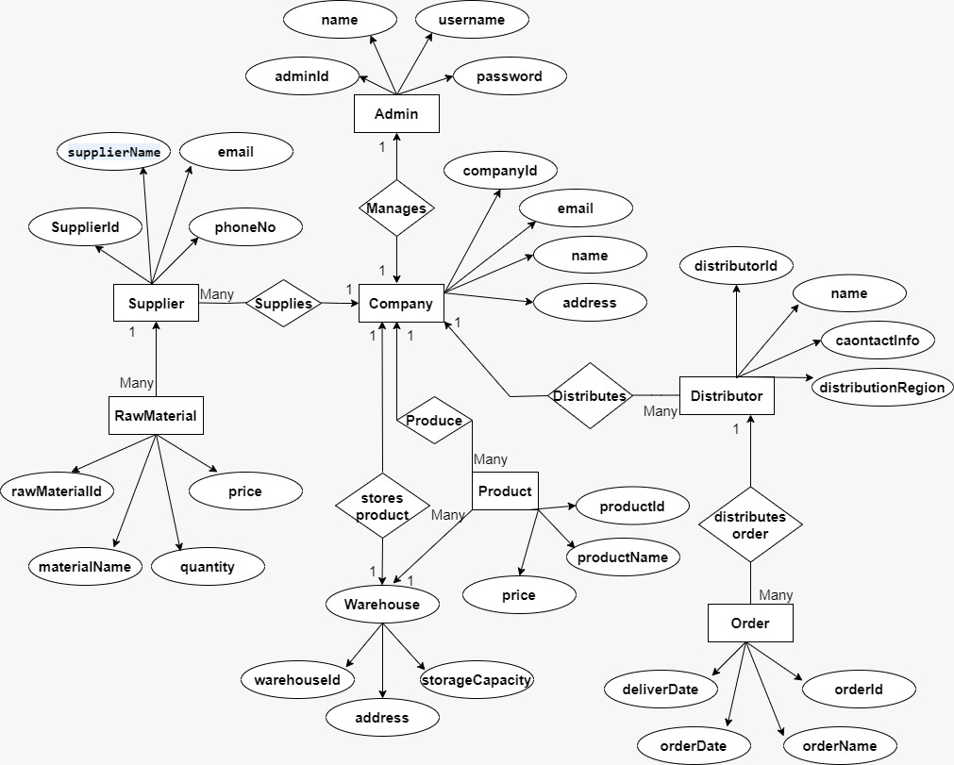
ER-Diagram

Slide 9
Technology
Backend
FrontEnd
Java
Springboot
SQL
JPA
HTML
CSS
Bootstrap
Angular

Slide 10
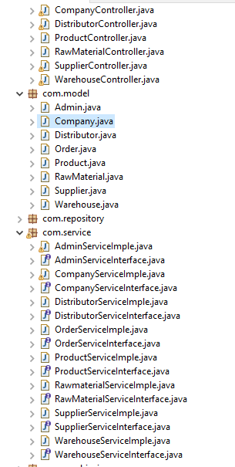
Implementation(Backend Development)
1 ) Encapsulation (Single Unit Of Processing)
2) Abstraction (Hiding implementaion and showing functionality

Slide 11
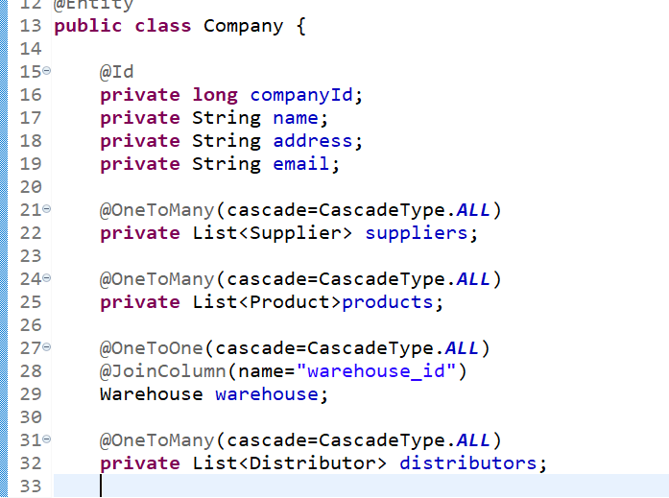
JPA Mappings
It is the mapping concept of the JPA specification due to which the Entity ( POJO ) classes are mapped with each other.
Without mapping project is not completed as there is no relation between the Entities

Slide 12
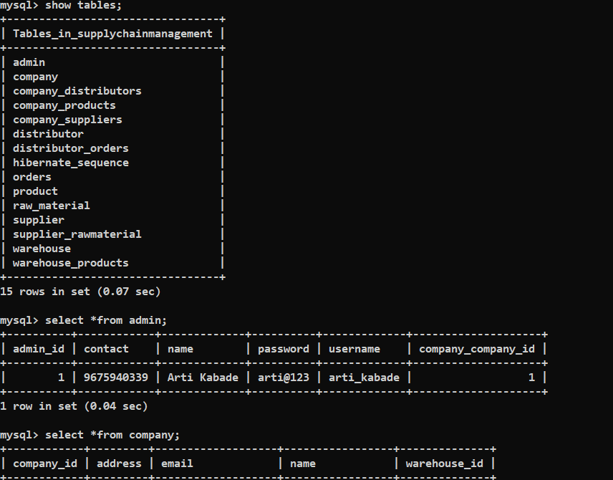
SQL Database

Slide 13
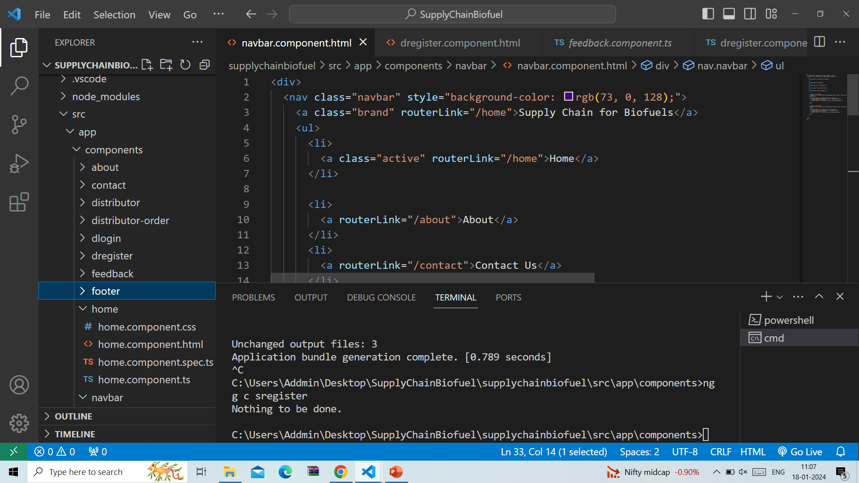
Angular Js
It is the front – end development for making a single page application with the connectivity between the user and the back – end software to communicate with each other .

Slide 14
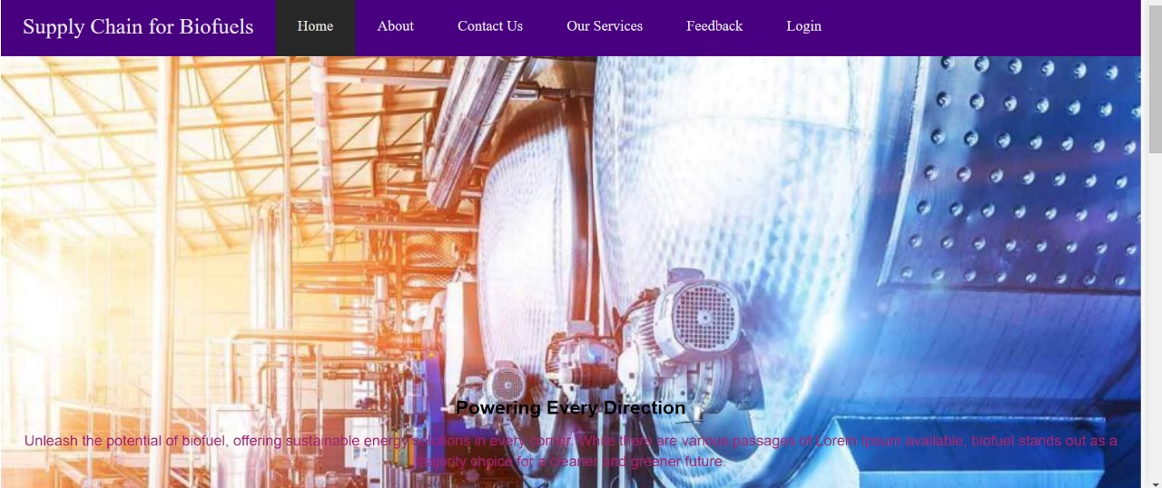
FrontEnd Pages(Home page)

Slide 15
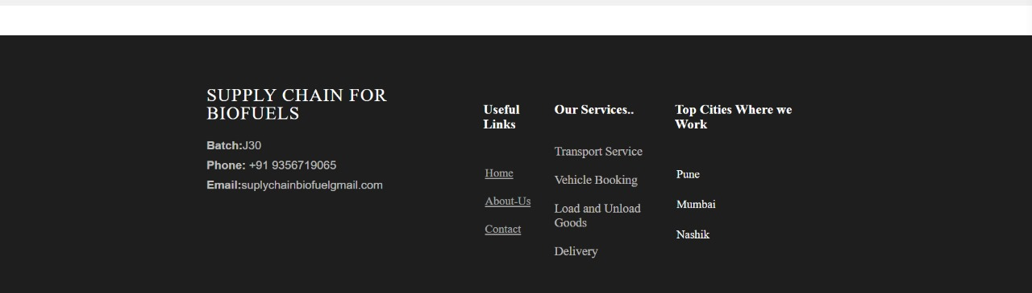
About

Slide 16
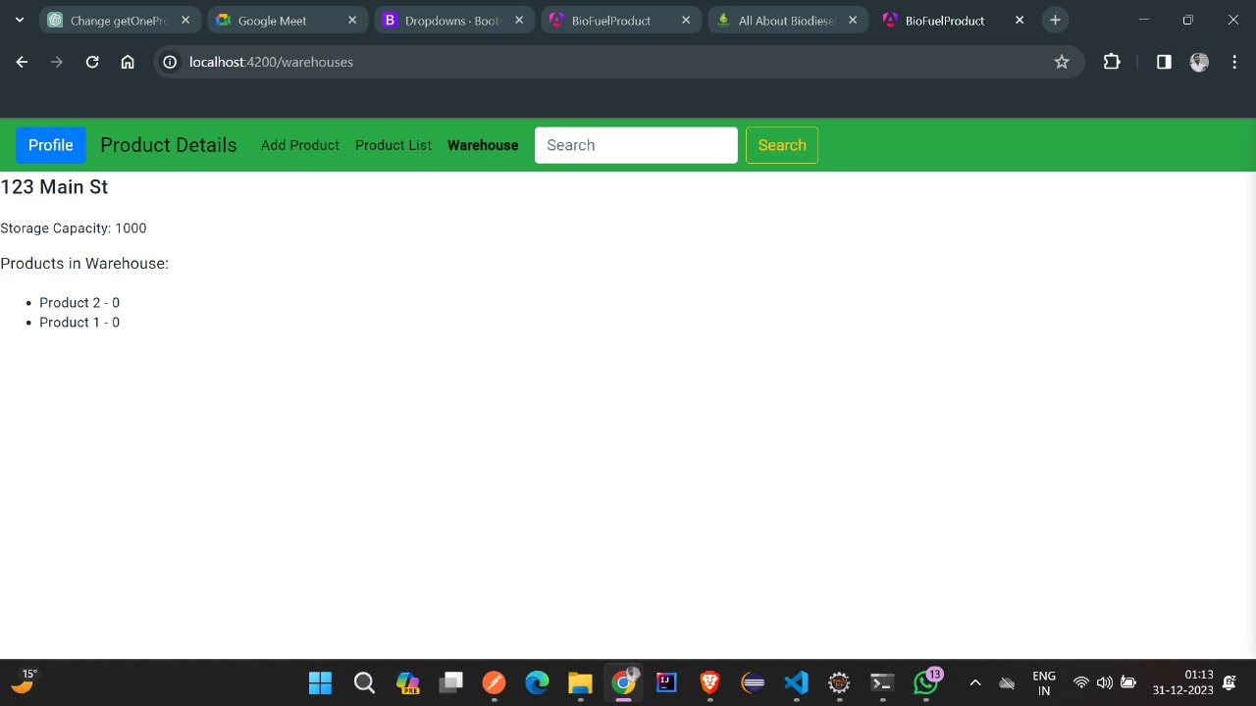
Product

Slide 17
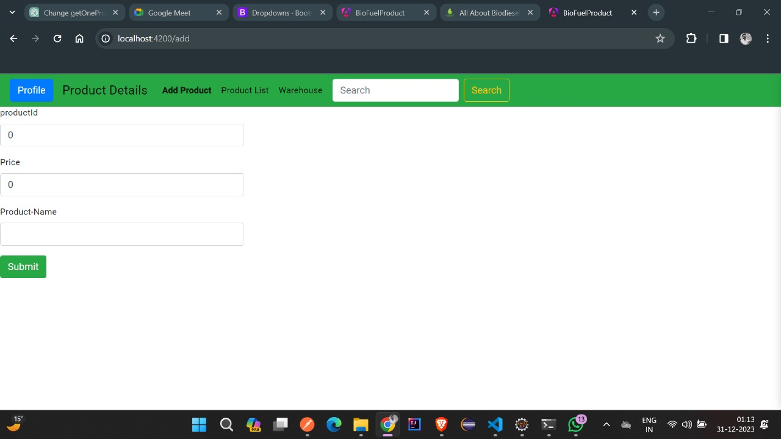
Products

Slide 18
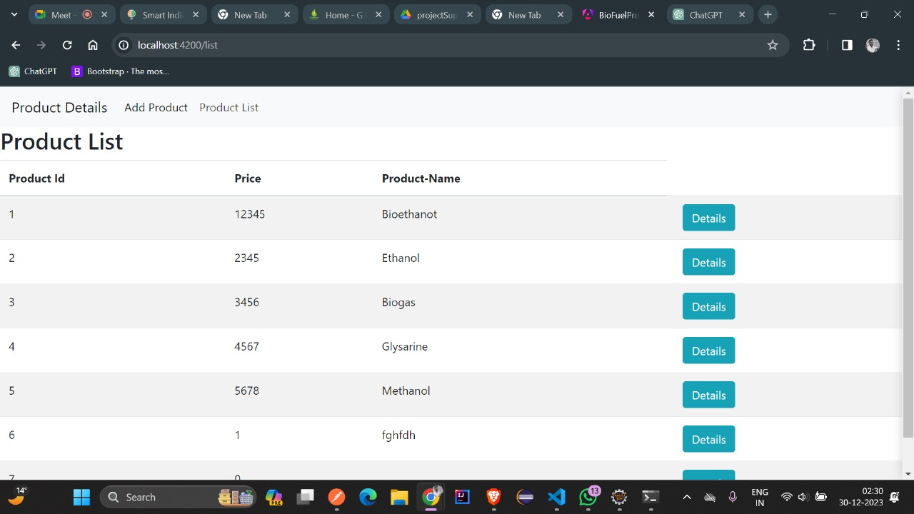

Slide 19
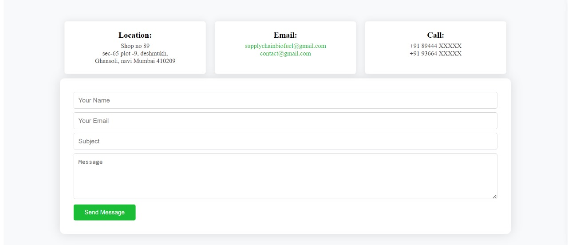
Contact

Slide 20
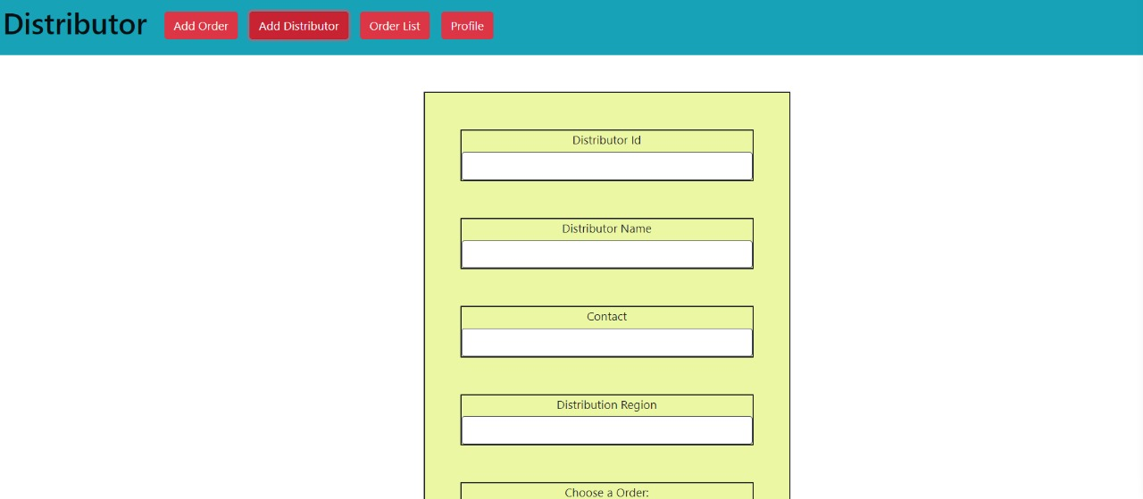
Distributor

Slide 21
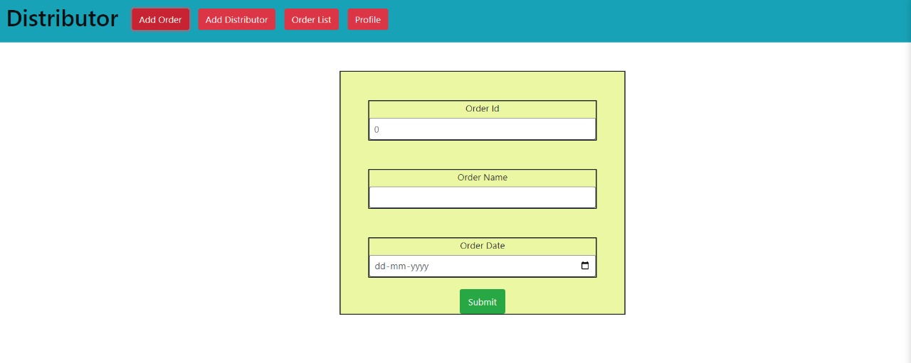
Distributor

Slide 22
Future Upgradation
In future in that project we can implement tracking system from source to destination.
Email updates .

Slide 23
Conclusion
In conclusion, the supply chain management project help to reduce the india’s financial expenditure.
This regular flow of biofuel can help for reducing foreign oil dependency.
It provides us positive economic impact as well as it provides High-Quality engine performance.

Slide 24
Thank You !!

